Slide 1
Prisons Week 2026
Prayer Meeting

Slide 2
Welcome
Notes:
For more than fifty years Prisons Week has prepared prayer literature to enable the Christian community, through individuals and churches, to pray for the needs of all those affected by prisons: prisoners and their families, victims of crime and their communities, those working in the criminal justice system and the many people who are involved in caring for those affected by crime on the inside and outside of our prisons.
Prisons Week raises awareness and generates prayer. It motivates volunteers to step forward and give their time and gifts, in prisons and in their own communities. It provides an annual focus and reason for Christians to work together, building capacity and motivation to make a difference for people who are out of sight and often out of mind.
The message at the heart of this parable of Jesus and of Prisons Week 2026 is beautifully captured by N.T. Wright: “Jesus’ love reaches us wherever we are but refuses to leave us as we are.” God’s desire is that all would respond to his invitation, both good and bad. Both good and bad require God’s clothes of righteousness. None is worthy. God seeks us out despite our behaviour and calls us to be changed; to take off the old and to put on the new.
And so, we invite you to respond to God’s invitation, maybe for the first time, maybe with renewed insight. Join us in prayer this Prisons Week, praying for those across the criminal justice system: victims of crime, offenders and those in custody, the families of all affected, those working in probation, prisons, police and courts and for chaplains and those administering care and justice communities.

Slide 3
The Prisons Week Prayer
Lord, you offer freedom to all people. We pray for those in prison. Break the bonds of fear and isolation that exist. Support with your love prisoners and their families and friends, prison staff and all who care. Heal those who have been wounded by the actions of others, especially the victims of crime. Help us to forgive one another, to act justly, love mercy and walk humbly together with Christ in his strength and his Spirit, now and every day.
Amen.

Slide 4
Intercessions
In today's Gospel, we hear of a King who prepares a banquet and invites all to come. Confident in God's generous love and mercy, let us bring before him the needs of the Church and of the world. We pray for the Church throughout the world. May we faithfully proclaim the good news that all are invited into God's kingdom.
Give us grace to welcome those who feel forgotten, excluded or ashamed, and help us to reflect Christ's compassion in all that we do.
Notes:
Leader to pray the left. Attendees to respond with the bold on the right.

Slide 5
Intercessions
We pray for all who are in prison. For those who are afraid, lonely or despairing; for those who carry deep regret; for those seeking a new beginning; and for those who have found faith while in custody. May they know that they are not beyond God's love and that Christ walks beside them even in the darkest places. We pray for victims of crime and for all whose lives have been marked by violence, abuse or loss.
Bring healing where there is pain, peace where there is fear, and hope where there is despair. Help us always to seek justice with compassion and truth with mercy.
Notes:
Leader to pray the left. Attendees to respond with the bold on the right.

Slide 6
Intercessions
We pray for prison chaplains, prison officers, governors, probation staff, healthcare workers, volunteers, and all who serve within the criminal justice system.
Grant them wisdom, patience, integrity and compassion in their daily work, and sustain them in the demanding responsibilities they carry.
Notes:
Leader to pray the left. Attendees to respond with the bold on the right.

Slide 7
Intercessions
We pray for families affected by imprisonment. We remember spouses, partners, parents, grandparents and especially children who live with separation, face stigma, uncertainty and loss.
Strengthen them with your love, surround them with supportive communities, and give them hope for the future.
Notes:
Leader to pray the left. Attendees to respond with the bold on the right.

Slide 8
Intercessions
We pray for those leaving prison and beginning again. Open doors of opportunity, provide suitable accommodation, meaningful work, supportive friendships and welcoming churches. We give thanks and offer our prayers for all those organisations working on the resettlement of those leaving prison.
Help us to see each person not through the lens of their past but through the hope of the new life that Christ offers.
Notes:
Leader to pray the left. Attendees to respond with the bold on the right.

Slide 9
Intercessions
We pray for ourselves. Where we have judged others harshly, forgive us. Where we have ignored your invitation, draw us back.
Clothe us with the new life of Christ, that we may live as people transformed by your grace and become faithful witnesses to your kingdom.
Merciful Father, Accept these prayers for the sake of your Son, our Saviour Jesus Christ. Amen.
Notes:
Leader to pray the left. Attendees to respond with the bold on the right.

Slide 10
The Langley Prayer
Father of compassion, be close to the lonely, be hope for the anxious, and to those in darkness be their light.
Lord Jesus Christ, you taught us to love our neighbour, and to care for those in need, strengthen us and all the Langley Family to comfort the fearful, to lift the broken-hearted and to assure the isolated of your love, and ours; for the glory of your kingdom and the beauty of your name.
Amen.
Notes:
Leader to read out the prayer. Attendees join the Amen in bold

Slide 11
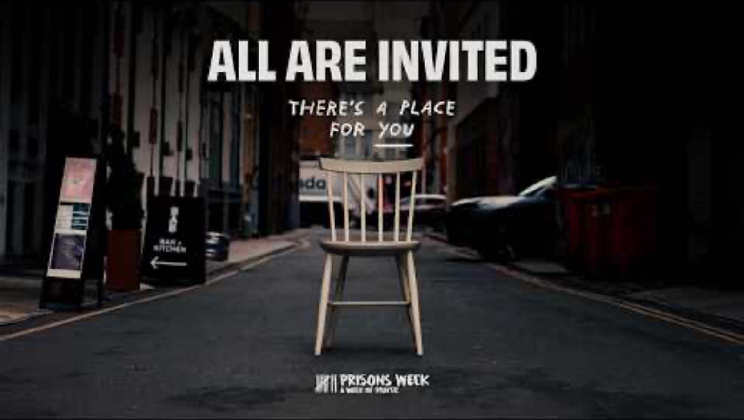
You’re Invited – Prisons Week Film

Slide 12
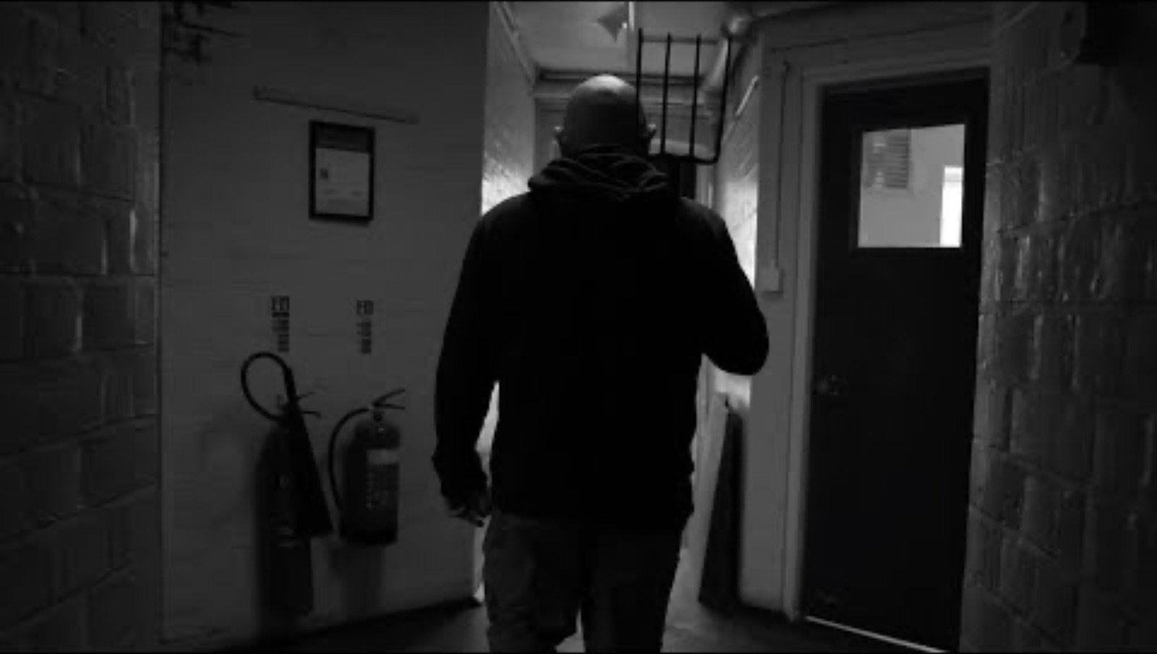
David’s Story – A Langley Client

Slide 13
Prayer Groups
Group 1 – Day 1: Bishop to Prisons
Group 2 – Day 2: The Bible Society
Group 3 – Day 3: The Welcome Directory
Group 4 – Day 4: Junction 42
Group 5 - Day 5: Langley Trust
Group 6 – Day 6: Caring for Prison Leavers
Group 7 – Day 7: Assemblies of God
Notes:
Split meeting into groups and assign prayers. Also encourage to pray for Langley Staff and Clients and the criminal justice sector as a whole.

Slide 14
The Grace
May the grace of our Lord Jesus Christ, and the love of God, and the fellowship of the Holy Spirit, be with us all evermore. Amen.
Notes:
Altogether for the grace

Slide 15
https://www.langleytrust.org/get-involved/
Notes:
Encourage people to find out more about Langley as you finish.

